Slide 1
Sample CI-CD Project
VARUN

Slide 2
Building CI-CD Pipeline
Launch instance & Download Java.
Install Wget(package) & Install Tomcat-8 .
Untar the tomcat by using Command tar –zvxf tomcat.
Change directory to Apache file.

Slide 3
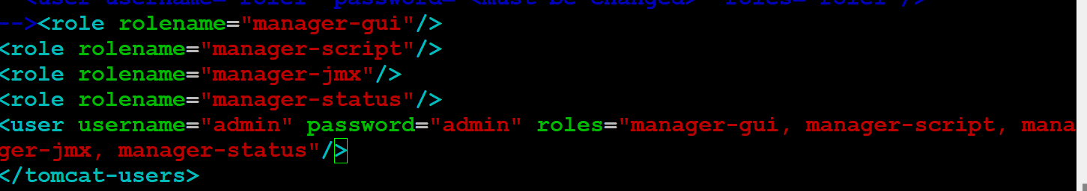
Change directory to conf & open the tomcat-user.xml by using vi editor.
Add the user data.

Slide 4
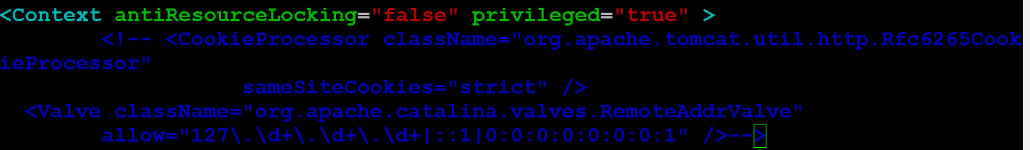
Change directory to cd webapps/manager/META-INF & edit the context.xml for manger
access.
Comment the cookieprocessor data.

Slide 5
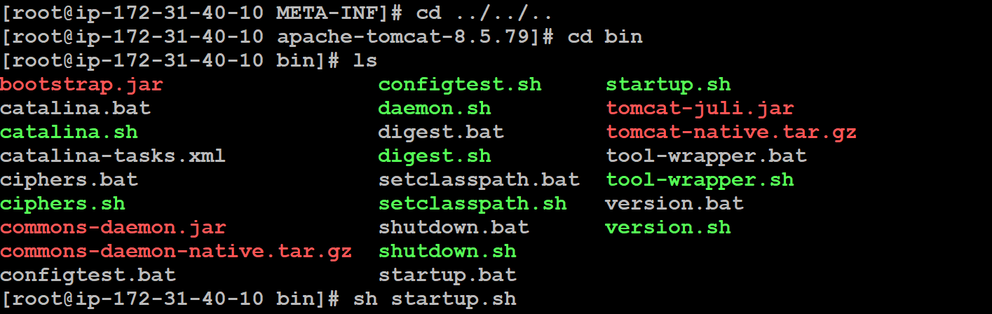
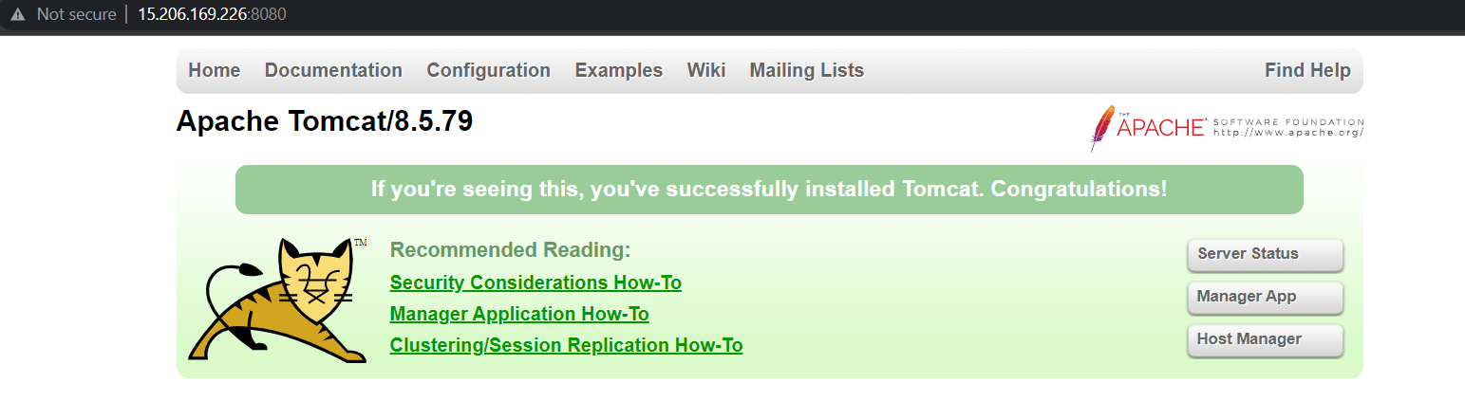
Start the tomcat service by running the startup.sh.
Copy the Instance Ip & paste it on browser with port ( IP:Port).

Slide 6
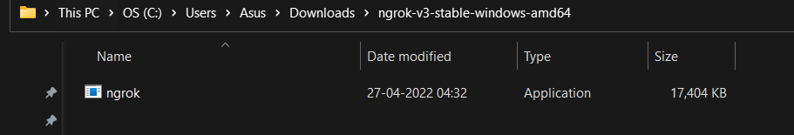
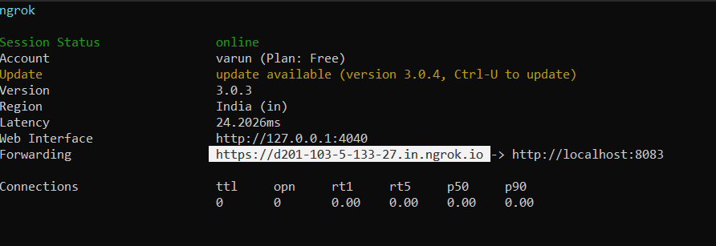
Open the ngrok application .
When we click on ngrok application It will open command prompt & enter the command ngrok http port(8083).
Copy the url .

Slide 7
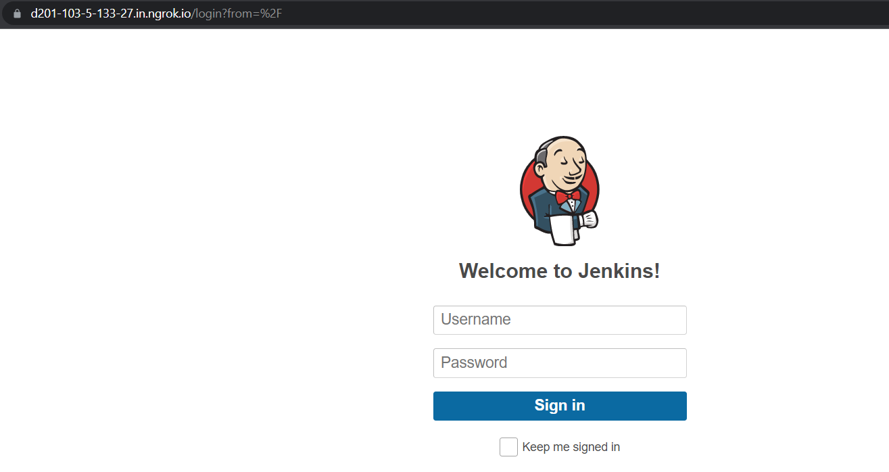
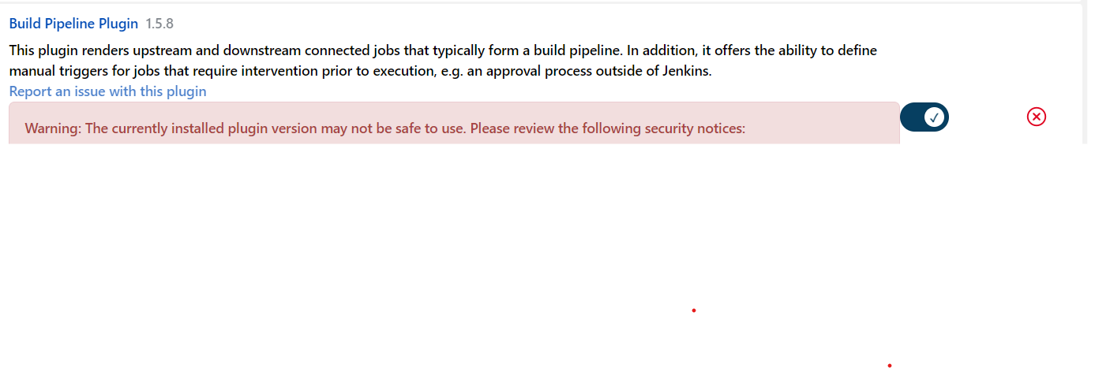
Paste the URL from Ngrok & It will open Jenkins.
Download the Build pipeline from Plugins.

Slide 8
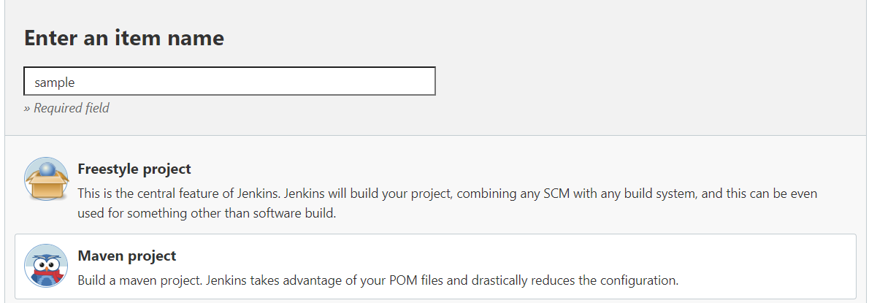
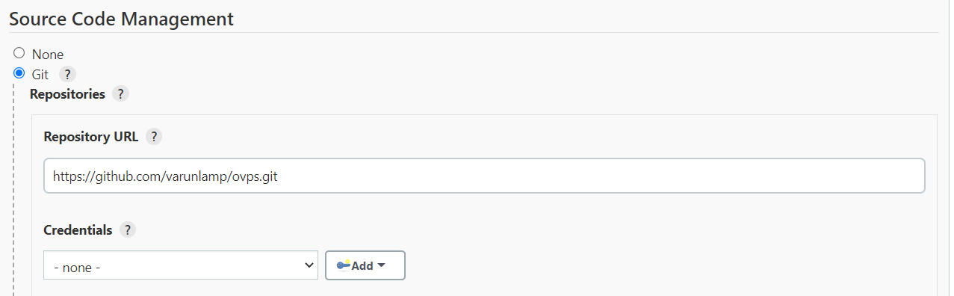
Click on new item & create a Free style project.
Click on source code management & Add the GitHub Sample project URL.

Slide 9
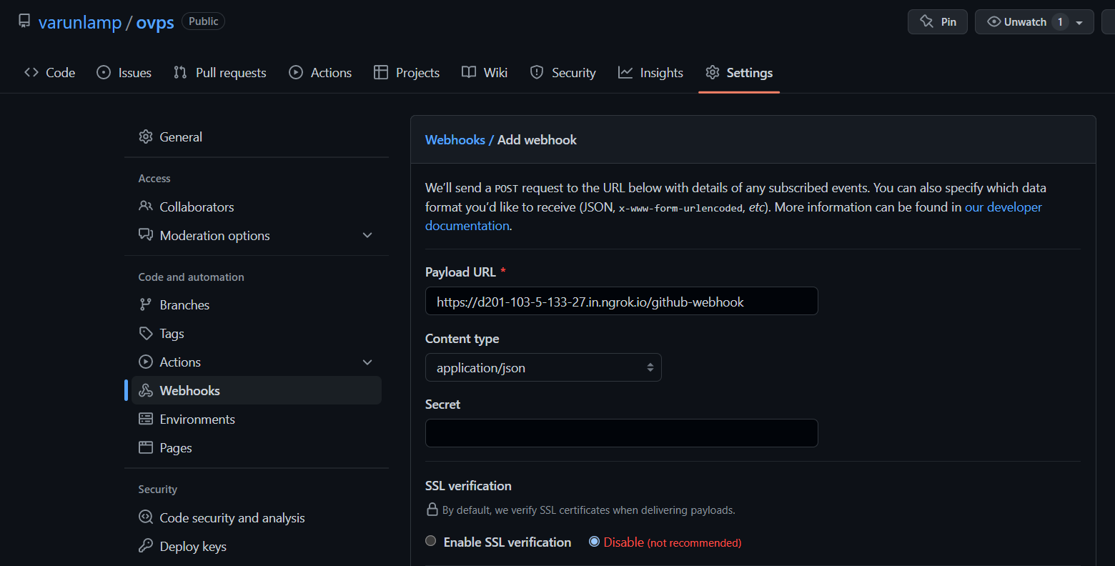
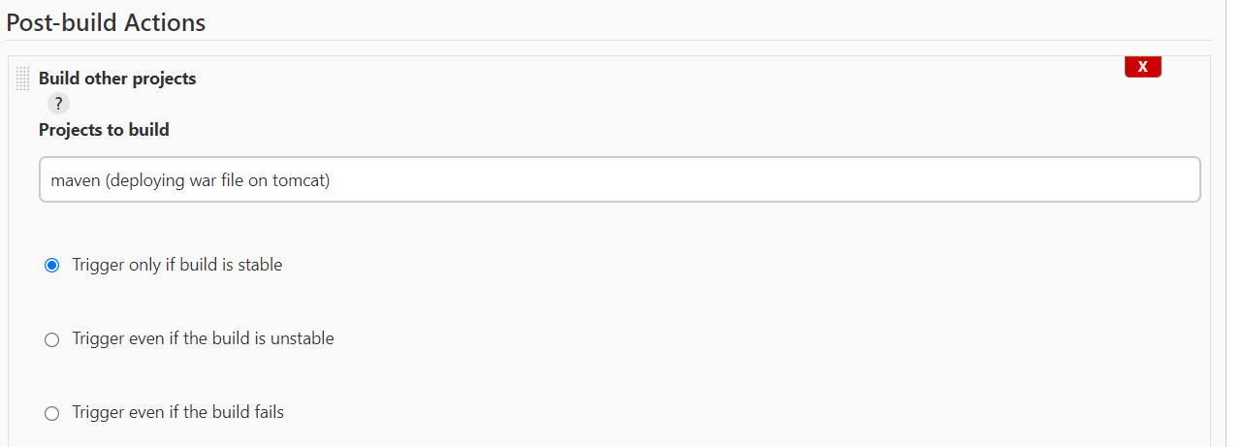
Paste the Ngrok URL in GitHub & Select GitHub Webhook in Jenkins.
Click on build other projects, Select the JOB & click on Save.

Slide 10
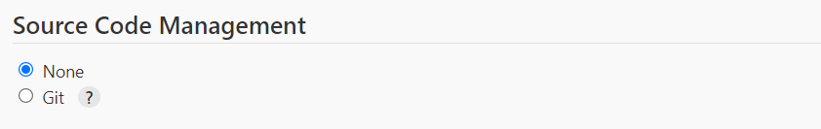
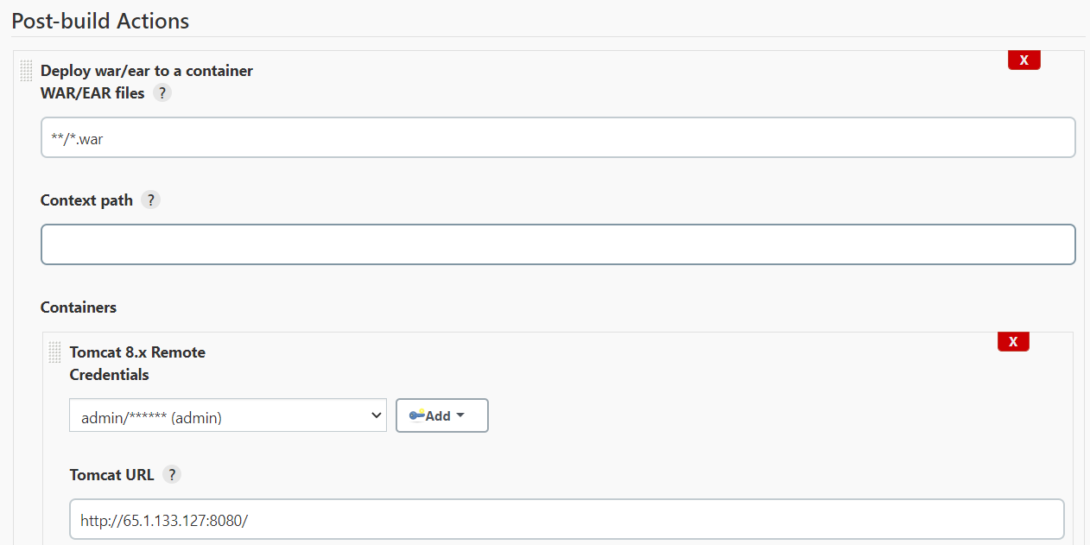
Continuous Delivery/Continuous deployment PART
Select the None.
Click on post build action & Give the Root path.

Slide 11
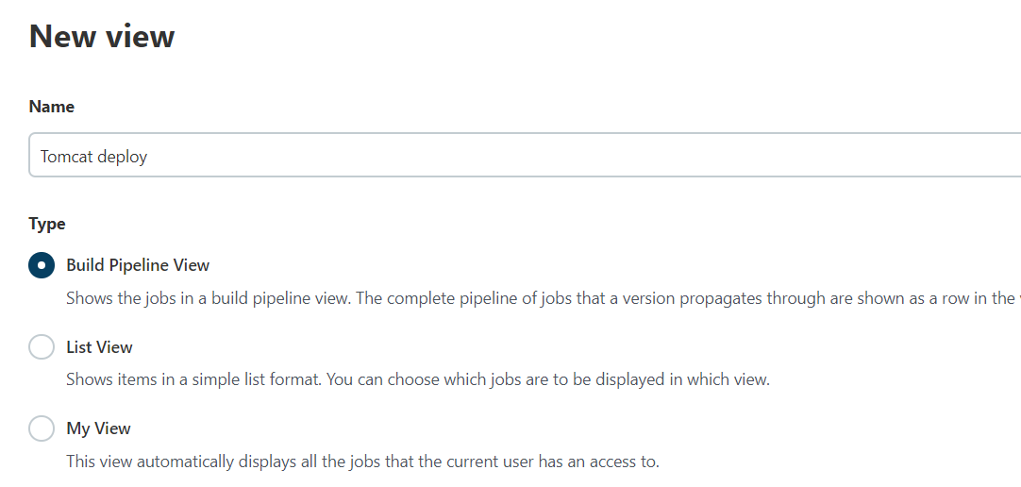
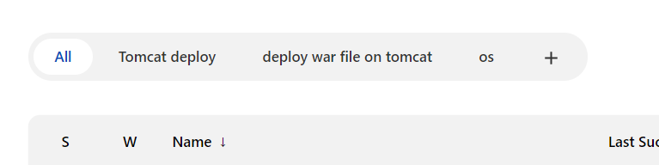
Click on New view & Give the Name & select the Build pipeline view.
Open dashboard & click on tomcat deploy.

Slide 12
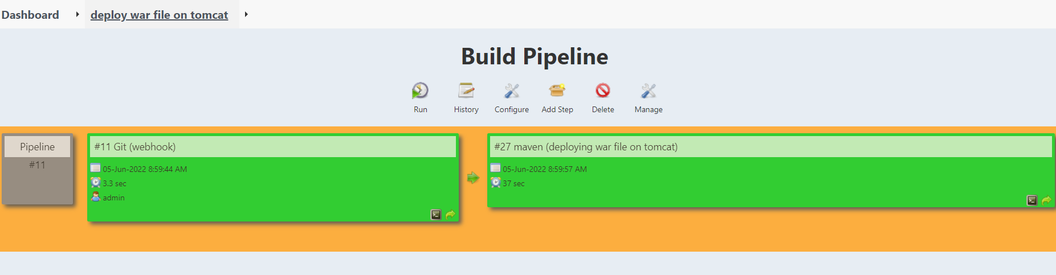
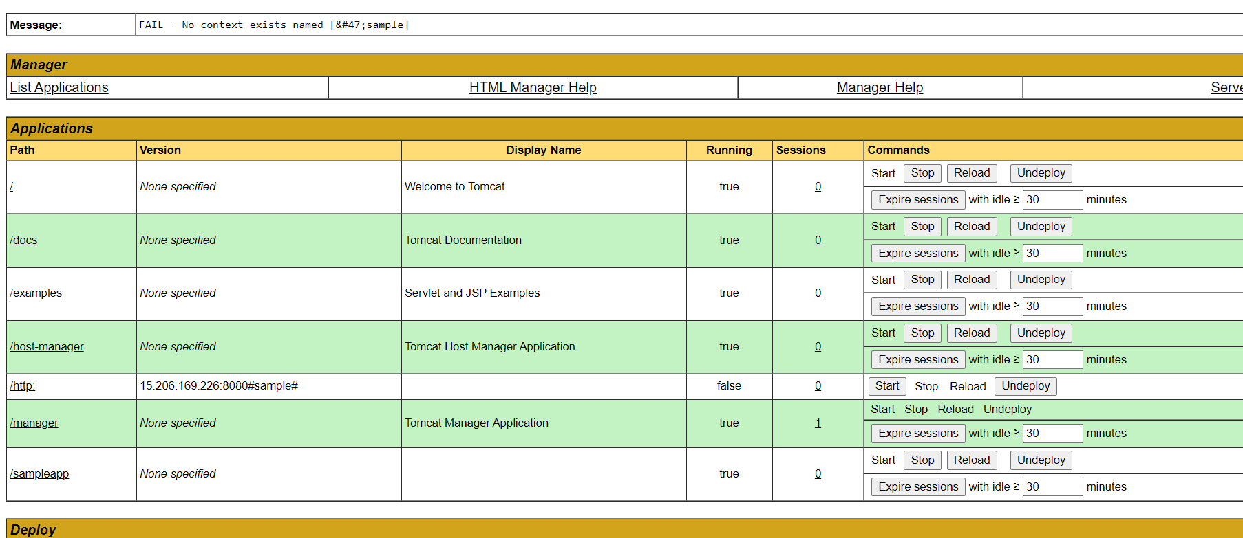
Click on RUN.
Check whether project is deployed.

Slide 13
Thank You

